Slide 1
Complane Airlines
Benjamin ADELINE
30/11/2017

Slide 2
Introduction
What is the context of your project? More and more airline traffic
Who is your customer (if applicable)? Free service, Financed by advertising (lawyers, legal counselling companies)
Which problem did you approach? Help people to gather to complain against airlines company

Slide 3
Discussions
Advantages, Disadvantages? Easy to reach people with the same issue Not always a solution for every case
Opportunities and Limits? Boom of airlines delays
Future Perspectives? Provide paying legal advices directly on the websites

Slide 4
Goals
How will you solve the problem? People will let comments with their issue with the name of the airline company and be able to have feedback to complain about their issues

Slide 5
System
Description Website Database
Architecture Database: Google Firebase Language: JavaScript Operating systems: Windows, IOS Server FTP

Slide 6
Design
Overview of the main requirements
Login Gmail account (Using Sign in API)
Safe database with google Firebase
Multi browser (Safari, Chrome, Mozilla…)
FTP Server for the Hosting

Slide 7
Evaluation
How will you evaluate the system? Evaluation with a live demonstration
What will be the results? We will be able to find a feedback with the same issue than me or for the same company

Slide 8
Demonstration
GUI (Screen Shots)

Slide 9
GUI

Slide 10
GUI

Slide 11
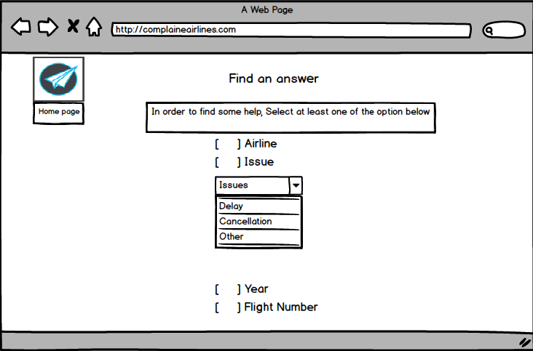
GUI

Slide 12
GUI

Slide 13
Firebase Authentication
<script src="https://cdn.firebase.com/libs/firebaseui/2.5.1/firebaseui.js"></script> <link type="text/css" rel="stylesheet"
href="https://cdn.firebase.com/libs/firebaseui/2.5.1/firebaseui.css" />
This will allow authentication trough google

Slide 14
Going Forward
Project Plan Connect the data base updated with the Firebase
Connect the API
Connect Pages between them with the results
Explain next steps Using

Slide 15
Questions?

